Slide 1
THE STORY OF YOUSSUF
The story of a political refugee.

Slide 2
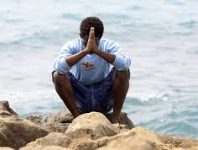
Youssuf is 29 years old and is a political refugee from Senegal that took three years to arrive in Italy. The duration is closely related to the economic question.
None of the migrants has all the money immediately, so it is necessary to stop in the various countries to work and earn new resources to continue the journey. His crossing was slow and complex. Characterized by the constant insecurity that the status of nilful refugee determines.

Slide 3
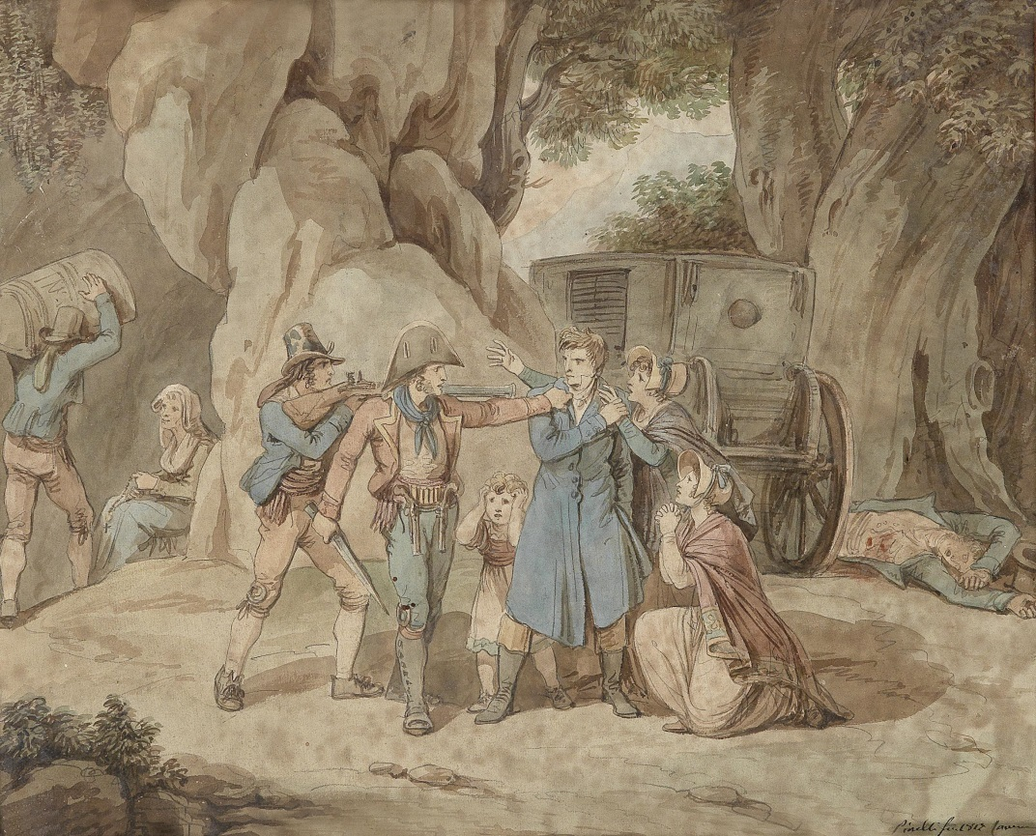
He escaped from Casamance, the southernmost region of Senegal, because he was forced: it is since 1982 that this area has been shaken by a separatist conflict. Although the civil war is, to date, under control, the episodes of banditry in the villages are the order of the day. "They come, they take you money and what you have. They often kill someone too. The rebels are uncontrollable "
Salif Sadio is the head of the Senegalese rebellion and it is he who still carries on a conflict that has little to do with politics.

Slide 4
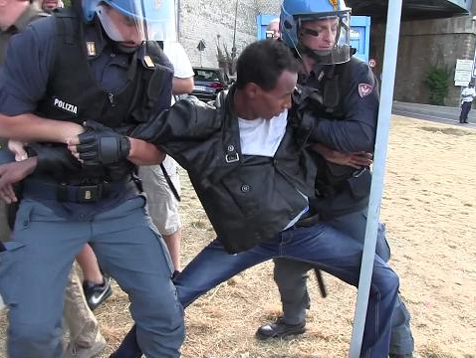
Youssuf explains that some companies organize trips from Senegal, via Mali and Burkina Faso, to Niger. Libya is too dangerous and refugees who arrive there are abandoned in the hands of local organizations. "From Casamance you can in the city of Tambacounda, from where you can make contacts to leave Transport is not expensive, this is the expensive journey are the unplanned outlays that the checkpoints, corrupt cops or bandits determine. the police, the agents are searching you and undressing you to see if you have hid some money ... If you do not have it, they will beat you or keep you from continuing ... I have been beaten and humiliated several times ".

Slide 5
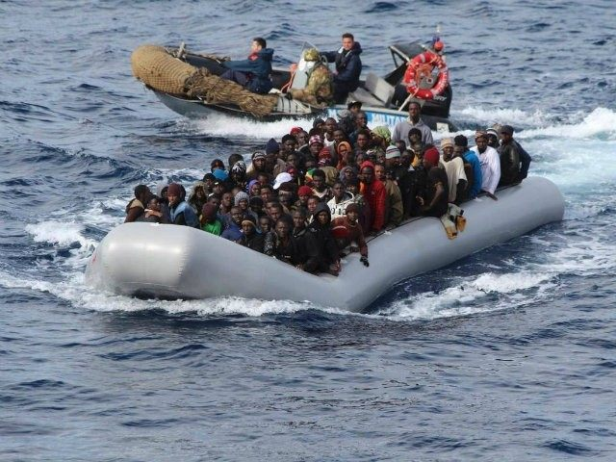
"It is normal to go to jail, it is often the same driver to take us in. I do not know how to explain it, it is a sort of trade, they are human traffickers, they sold us to the police, not so well because they would jail you in Tripoli and then they relocate you to other cities ". Youssuf says that the worst moments lived in Libya. Immediately he had to deal with death. The police that has them in custody was attacked by a group of guerrillas. A gunfight broke out: I found shelter from the chaos of dust and bullets under a canopy, and the agents, from there, tried to repel the attack. At the third policeman who saw himself fall in front of him, Youssuf was sure to die. Only the intervention of another squadron of police allowed to get them alive to the prison. Overall, Youssuf was in prison for 4 months. During this month, for a month and a half he received 10 centiliters of water and 50 grams of rice a day. "So good is poverty, but I have never suffered fame so much".
After leaving the prison, Youssuf was ready to do anything to leave that state so inhospitable. "The trip to Italy is very expensive (1200 Dinar, about 700 euros) and it took me about two years to accumulate the money that, gradually, I gave to the smuggler".

Slide 6
From Youssuf's account it emerges that the great difficulty is faced during the phase in which it is a pawn in the hands of bosses who exploit and contract in prison.
Collected the necessary money and little more for emergencies, Youssuf has set sail. "When I saw Italian police, I burst into tears and thanked Allah for bringing me alive".
He stayed at sea for three days. When I asked him if the crossing was tough, he replied with a smile: "After all I've been through, the crossing was a joke".

Slide 7
THE END
-Vittorio Pirrotta 2°G

